Slide 1
Digital Circuit Experiment Decoder and Data Selector
Lecture 3
Rencan Nie（聂仁灿）

Slide 2
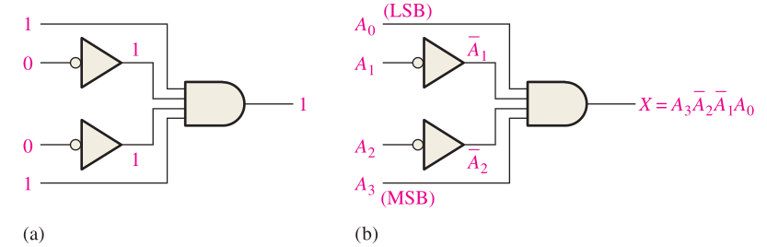
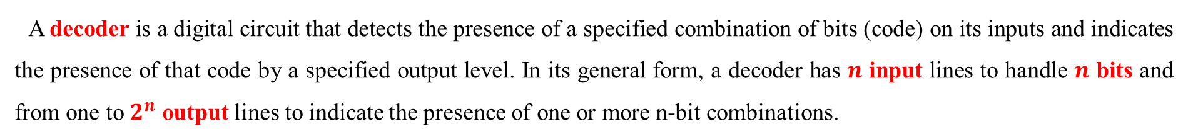
Theoretical Basis
Decoders
A decoder is a digital circuit that detects the presence of a specified combination of bits (code) on its inputs and indicates the presence of that code by a specified output level. In its general form, a decoder has $n$ input lines to handle $n$ bits and from one to $2^{n}$ output lines to indicate the presence of one or more n-bit combinations.
Basic Binary Decoder
Suppose you need to determine when a binary 1001 occurs on the inputs of a digital circuit. An AND gate can be used as the basic decoding element because it produces a HIGH output only when all of its inputs are HIGH.
For this end, you must make sure that all of the inputs to the AND gate are HIGH when the binary number 1001 occurs; this can be done by inverting the two middle bits (the 0s), as shown in the following.

Slide 3
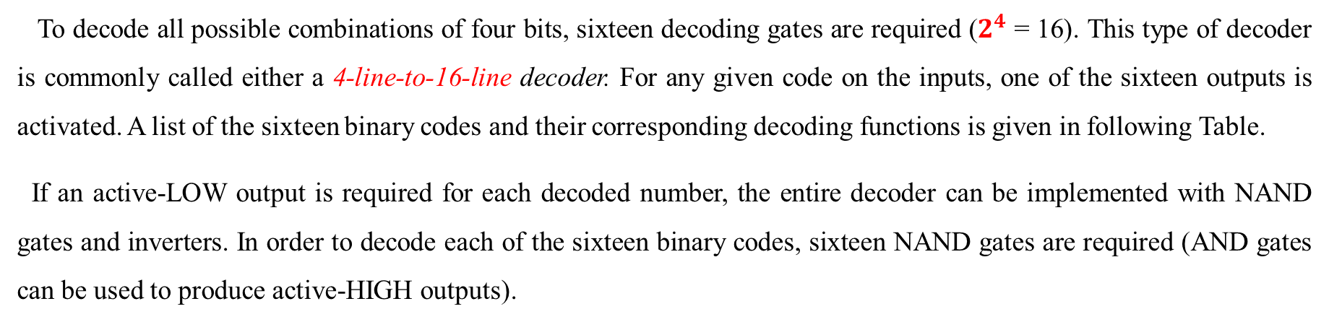
Theoretical Basis
Decoders
4-Bit Decoder
To decode all possible combinations of four bits, sixteen decoding gates are required ($2^{4}$ = 16). This type of decoder is commonly called either a 4-line-to-16-line decoder. For any given code on the inputs, one of the sixteen outputs is activated. A list of the sixteen binary codes and their corresponding decoding functions is given in following Table.
If an active-LOW output is required for each decoded number, the entire decoder can be implemented with NAND gates and inverters. In order to decode each of the sixteen binary codes, sixteen NAND gates are required (AND gates can be used to produce active-HIGH outputs).

Slide 4
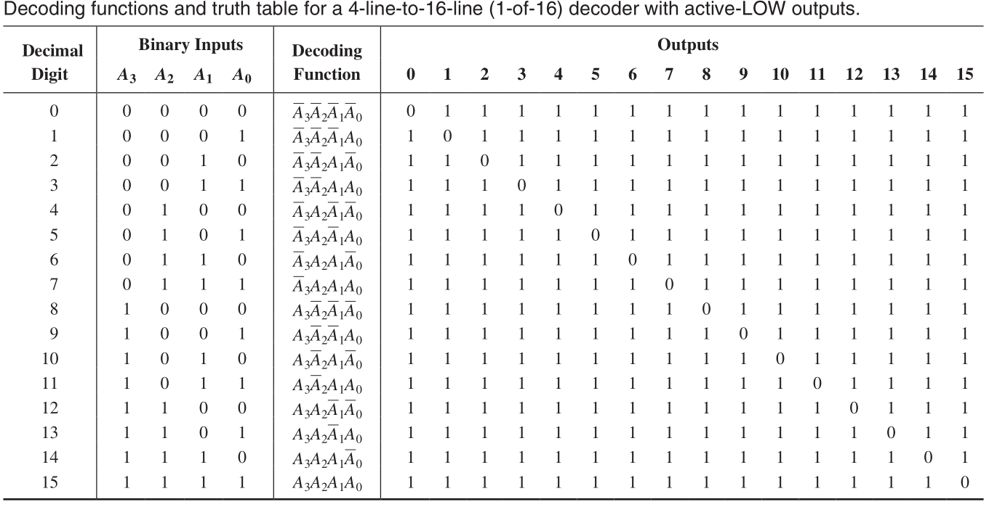
Theoretical Basis
Decoders
4-Bit Decoder

Slide 5
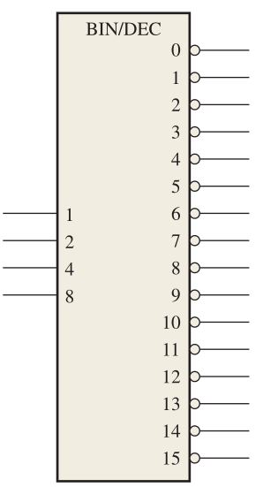
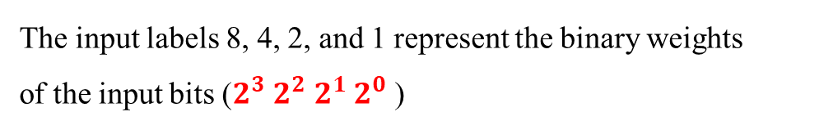
Theoretical Basis
Decoders
4-Bit Decoder
A logic symbol for a 4-line-to-16-line (1-of-16) decoder with active-LOW outputs is shown in following Figure. The BIN/DEC label indicates that a binary input makes the corre-sponding decimal output active.
The input labels 8, 4, 2, and 1 represent the binary weights
of the input bits ($2^{3}$ $2^{2}$ $2^{1}$ $2^{0}$ )

Slide 6
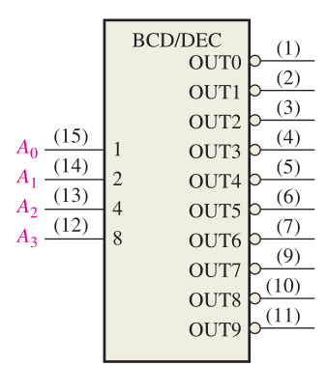
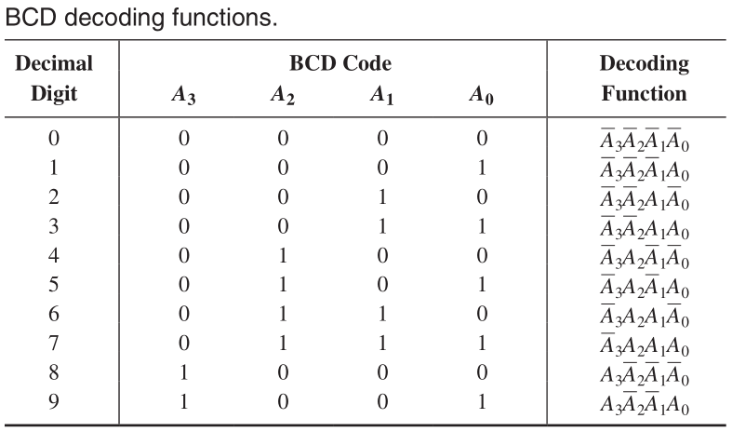
Theoretical Basis
Decoders
BCD-to-Decimal Decoder
The BCD-to-decimal decoder converts each BCD code (8421 code) into one of ten possible decimal digit indications. It is frequently referred as a 4-line-to-10-line decoder or a 1-of-10 decoder.
The method of implementation is the same as for the 1-of-16 decoder previously discussed, except that only ten decoding gates are required

Slide 7
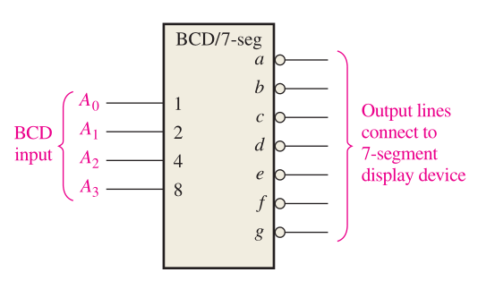
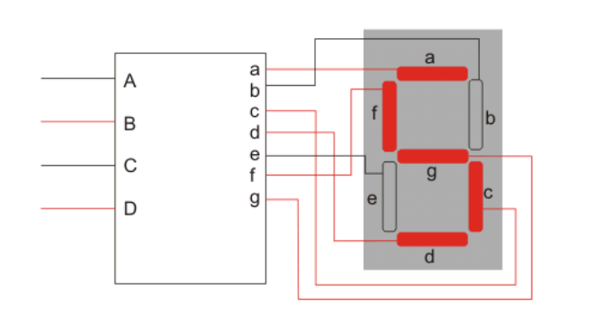
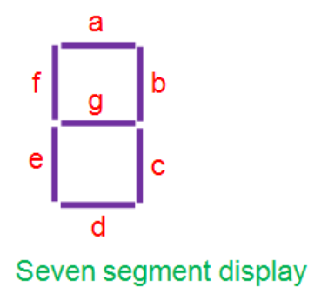
Theoretical Basis
Decoders
BCD-to-7-Segment Decoder
The BCD-to-7-segment decoder accepts the BCD code on its inputs and provides outputs to drive 7-segment display devices to produce a decimal readout. The logic diagram for a basic 7-segment decoder is shown in following Figure.

Slide 8
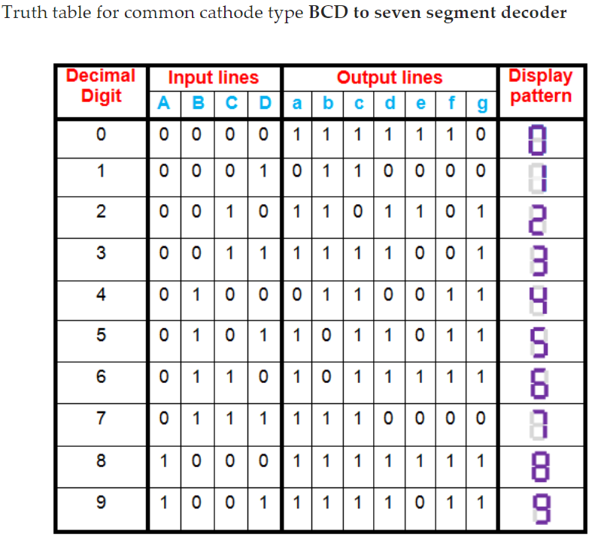
Theoretical Basis
Decoders
BCD-to-7-Segment Decoder

Slide 9
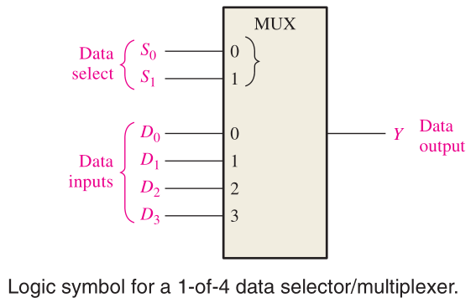
Theoretical Basis
Multiplexers (Data Selectors)
A multiplexer (MUX) is a device that allows digital information from several sources to be routed onto a single line for transmission over that line to a common destination.
A logic symbol for a 4-input multiplexer (MUX) is shown in the following Figure. Notice that there are two data-select lines because with two select bits, any one of the four data-input lines can be selected.

Slide 10
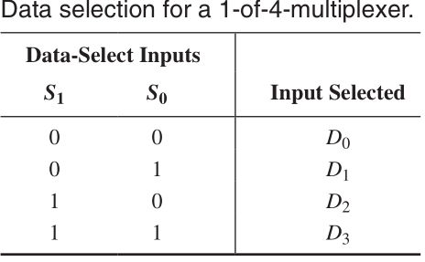
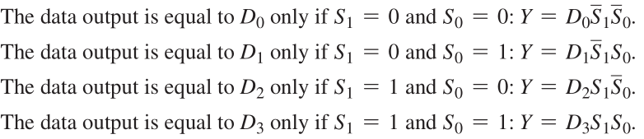

Theoretical Basis
Multiplexers (Data Selectors)
A multiplexer (MUX) is a device that allows digital information from several sources to be routed onto a single line for transmission over that line to a common destination.

Slide 11
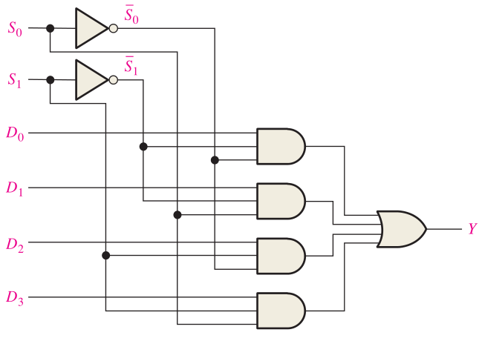

Theoretical Basis
Multiplexers (Data Selectors)
A multiplexer (MUX) is a device that allows digital information from several sources to be routed onto a single line for transmission over that line to a common destination.

Slide 12
Experiments
Experimental purposes
Familiar with the integrated decoder and dada selector.
Understand the application with integrated decoder and dada selector.
Learn how to design a combinational circuit using integrated decoder and dada selector.

Slide 13
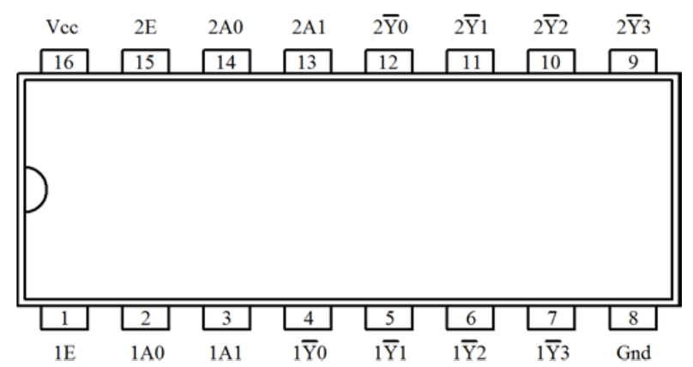
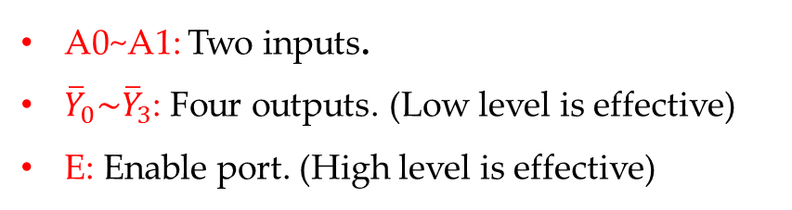
Experimental Contents
1. Function test for a Decoder
Task 1: Test the function for a Decoder with 74LS139.
74LS139 is a double 2 line-to-4 line Decoder.
A0~A1: Two inputs.
${\overline{Y}}_{0}\sim {\overline{Y}}_{3}$: Four outputs. (Low level is effective)
E: Enable port. (High level is effective)

Slide 14
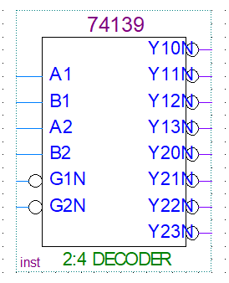
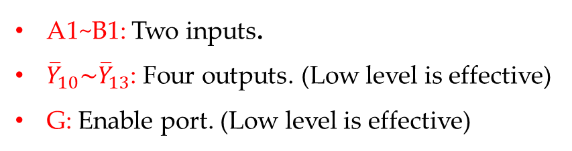
Experimental Contents
1. Function test for a Decoder
Task 1: Test the function for a Decoder with 74LS139.
74LS139 in Quartus.
A1~B1: Two inputs.
${\overline{Y}}_{10}\sim {\overline{Y}}_{13}$: Four outputs. (Low level is effective)
G: Enable port. (Low level is effective)

Slide 15
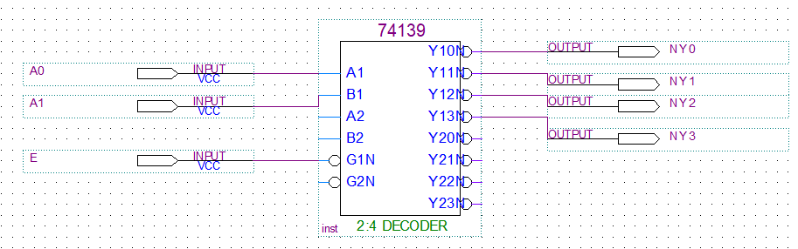
Experimental Contents
1. Function test for a Decoder
Task 1: Test the function for a Decoder with 74LS139.
Step 1: Design the circuit in Quartus 13.1

Slide 16
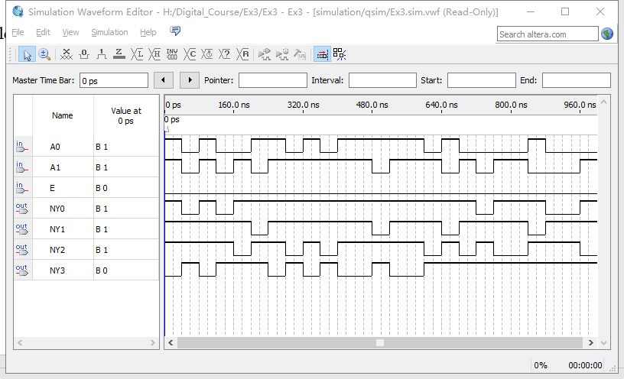
Experimental Contents
1. Function test for a Decoder
Task 1: Test the function for a Decoder with 74LS139.
Step 2: Step 2: Compile the designed file, and construct the VMF to watch the simulation results.
Fille the results into Table 3.1.
Note that: set E as 0.

Slide 17
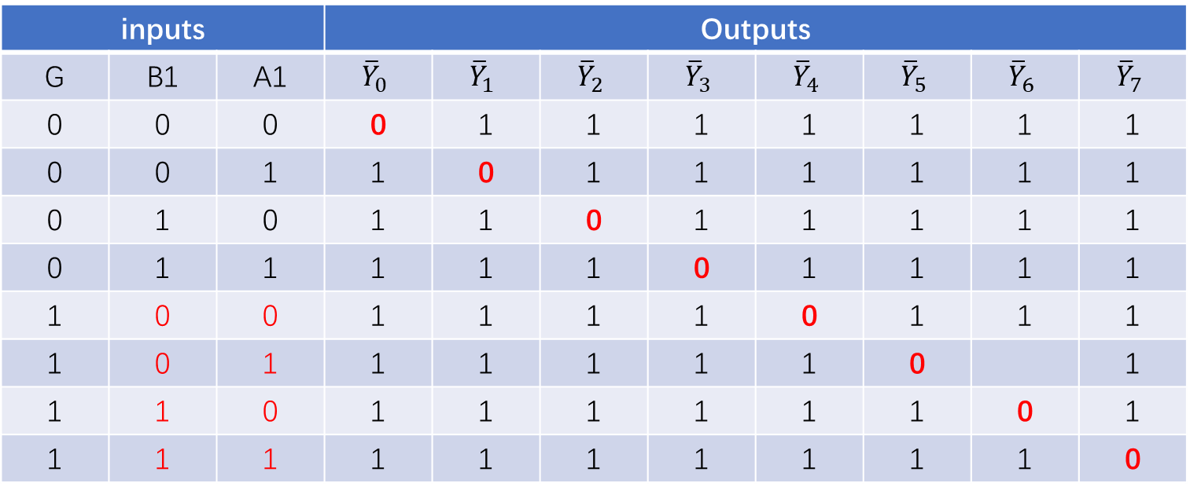
Experimental Contents
2. Decoder Conversion
Task 2: Use two 2-4 Decoders (74LS139) to design a 3-8 Decoder.
Idea: Use the enable port to extend the number of the outputs.
Step 1: Present the Function Table
inputs |  |  | Outputs
G | B1 | A1 | $${\overline{Y}}_{0}$$ | $${\overline{Y}}_{1}$$ | $${\overline{Y}}_{2}$$ | $${\overline{Y}}_{3}$$ | $${\overline{Y}}_{4}$$ | $${\overline{Y}}_{5}$$ | $${\overline{Y}}_{6}$$ | $${\overline{Y}}_{7}$$
0 | 0 | 0 | 0 | 1 | 1 | 1 | 1 | 1 | 1 | 1
0 | 0 | 1 | 1 | 0 | 1 | 1 | 1 | 1 | 1 | 1
0 | 1 | 0 | 1 | 1 | 0 | 1 | 1 | 1 | 1 | 1
0 | 1 | 1 | 1 | 1 | 1 | 0 | 1 | 1 | 1 | 1
1 | 0 | 0 | 1 | 1 | 1 | 1 | 0 | 1 | 1 | 1
1 | 0 | 1 | 1 | 1 | 1 | 1 | 1 | 0 |  | 1
1 | 1 | 0 | 1 | 1 | 1 | 1 | 1 | 1 | 0 | 1
1 | 1 | 1 | 1 | 1 | 1 | 1 | 1 | 1 | 1 | 0
Enable G2N = 0

Slide 18
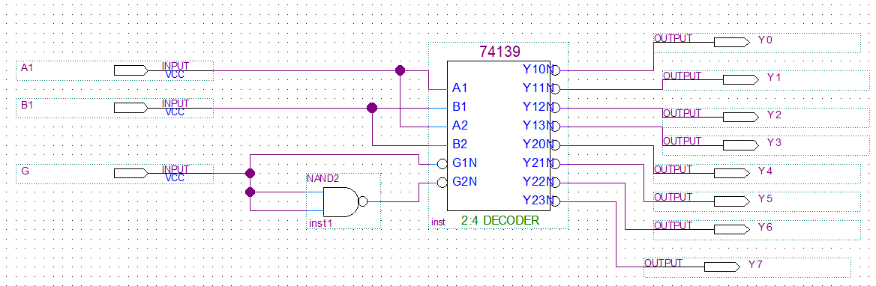
Experimental Contents
2. Decoder Conversion
Task 2: Use two 2-4 Decoders (74LS139) to design a 3-8 Decoder.
Idea: Use the enable port to extend the number of the outputs.
Step 2: Design the circuit in Quartus 13.1

Slide 19
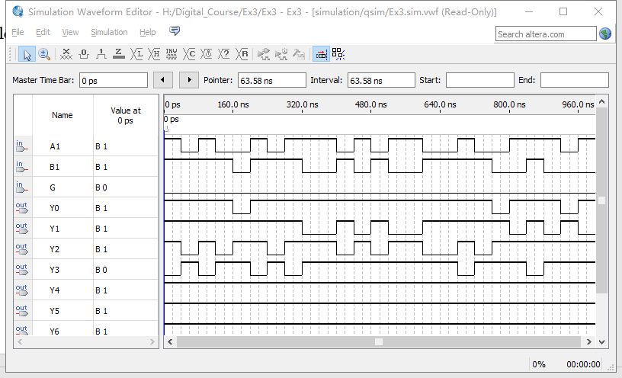
Experimental Contents
2. Decoder Conversion
Task 1: Test the function for a Decoder with 74LS139.
Step 2: Step 2: Compile the designed file, and construct the VMF to watch the simulation results.
Fille the results into Table 3.1.
Note that: set G as 0 and 1, respectively.

Slide 20
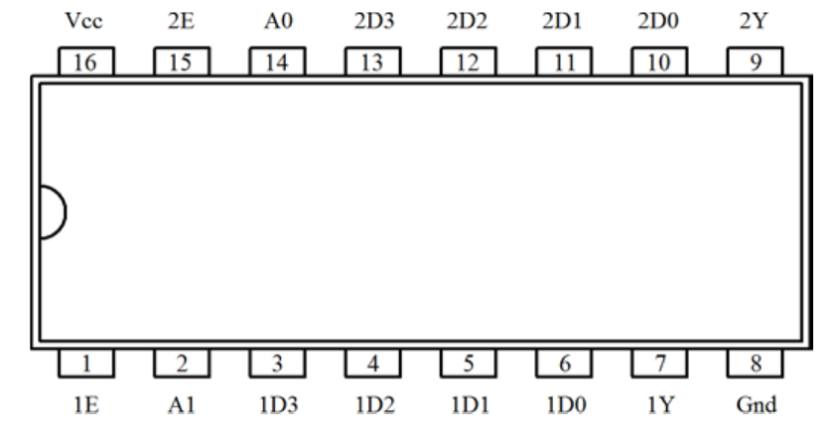
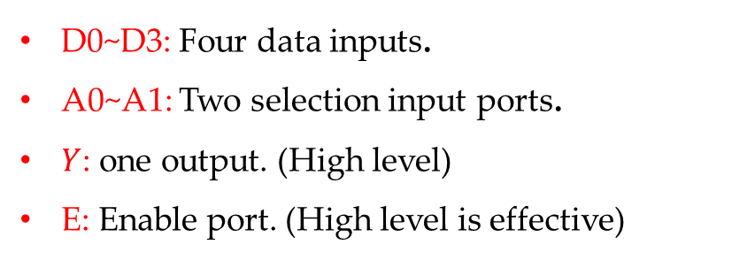
Experimental Contents
3. Function test for a Data selector
Task 1: Test the function for a Data selector with 74LS153.
74LS153 is a double Data selector to four resource data.
D0~D3: Four data inputs.
A0~A1: Two selection input ports.
$Y$: one output. (High level)
E: Enable port. (High level is effective)

Slide 21
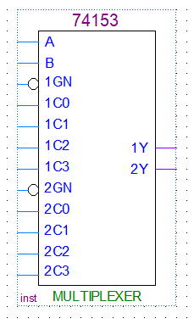
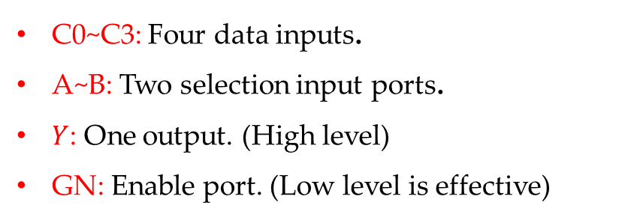
Experimental Contents
3. Function test for a Data selector
Task 1: Test the function for a Data selector with 74LS153.
74LS153 in Quartus.
C0~C3: Four data inputs.
A~B: Two selection input ports.
$Y$: One output. (High level)
GN: Enable port. (Low level is effective)

Slide 22
Experimental Contents
3. Function test for a Data selector
Task 1: Test the function for a Data selector with 74LS153.
The function table for 74LS153 in Quartus.
GN | B | A | 1Y | 2Y
1 | X | X | 0 | 0
0 | 0 | 0 | 1C0 | 2C0
0 | 0 | 1 | 1C1 | 2C1
0 | 1 | 0 | 1C2 | 2C2
0 | 1 | 1 | 1C3 | 2C3

Slide 23
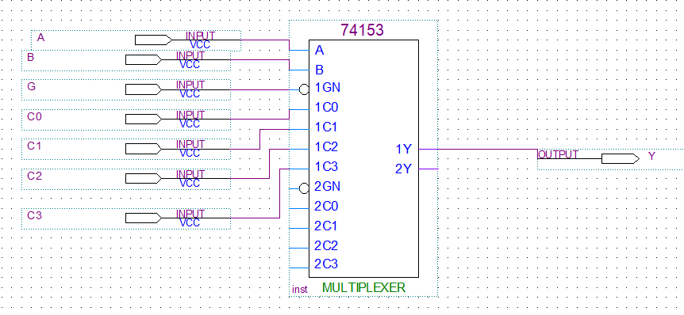
Experimental Contents
3. Function test for a Data selector
Task 1: Test the function for a Data selector with 74LS153.
Idea: Use the enable port to extend the number of the outputs.
Step 1: Design the circuit in Quartus 13.1

Slide 24
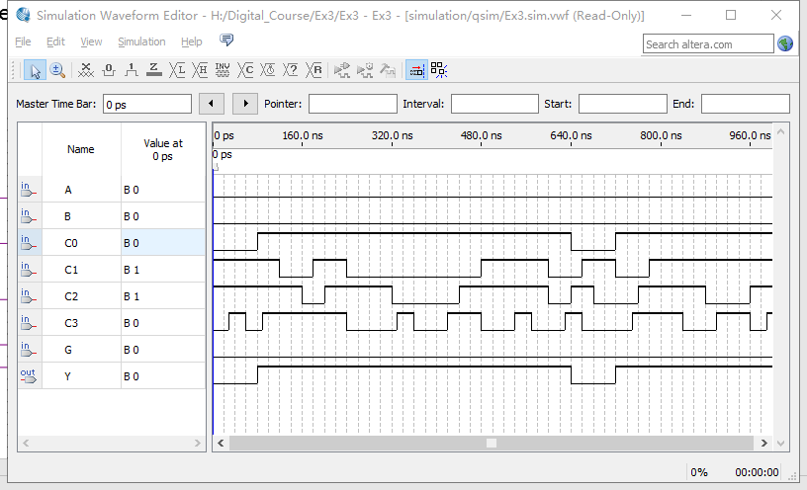
Experimental Contents
3. Function test for a Data selector
Task 1: Test the function for a Data selector with 74LS153.
Step 2: Compile the designed file, and construct the VMF to watch the simulation results.
Fille the results into Table 3.2.
Note that: set G as 0
This is a example to select C0.

Slide 25
Thanks

